Slide 1
11/9/2022
Exercise 10: Umbrella Sampling
Binding free energy calculations
YANK, a software package for binding free energy calculations

Slide 2
Exercise 10: Umbrella Sampling
colab

Slide 3
Binding Free Energy Calculations
This lecture will include
the theory of binding free energy calculations
a tour of YANK, a software package for computing binding free energies
At the end of this lecture, you should be able to answer the following questions:
How do binding free energy calculations differ from molecular docking?
What is a thermodynamic cycle? What types of thermodynamic cycles are used in binding free energy calculations?
What is an alchemical transformation?

Slide 4

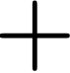

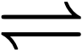
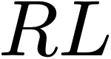
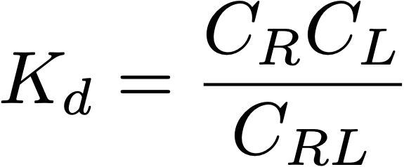


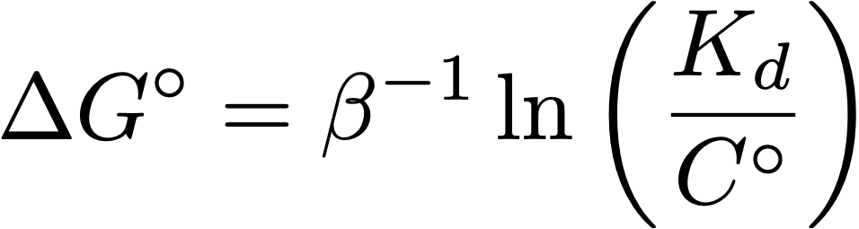


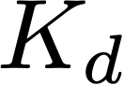
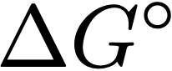
ΔG○ quantifies binding strength
free receptor concentration
dissociation constant
free ligand concentration
complex concentration
standard state concentration (1 M)
binding free energy
highest biological
affinity
good drugs
lead compounds
weak
biomolecular
fM
pM
nM
μM
mM
M
STRONG
WEAK
-20.8
-16.6
-12.4
-8.3
-4.1
0
kcal/mol
biotin:streptavidin
lipitor:HMG-CoA
reductase
benzamidine:
bovine trypsin
ATP:kinase
Notes:
We are considering a noncovalent association process. It has a equilibrium constant and binding free energy. Free energies include enthalpy and entropy
\Delta G^\circ = \beta^{-1} \ln \left( \frac{K_d}{C^\circ} \right)

Slide 5
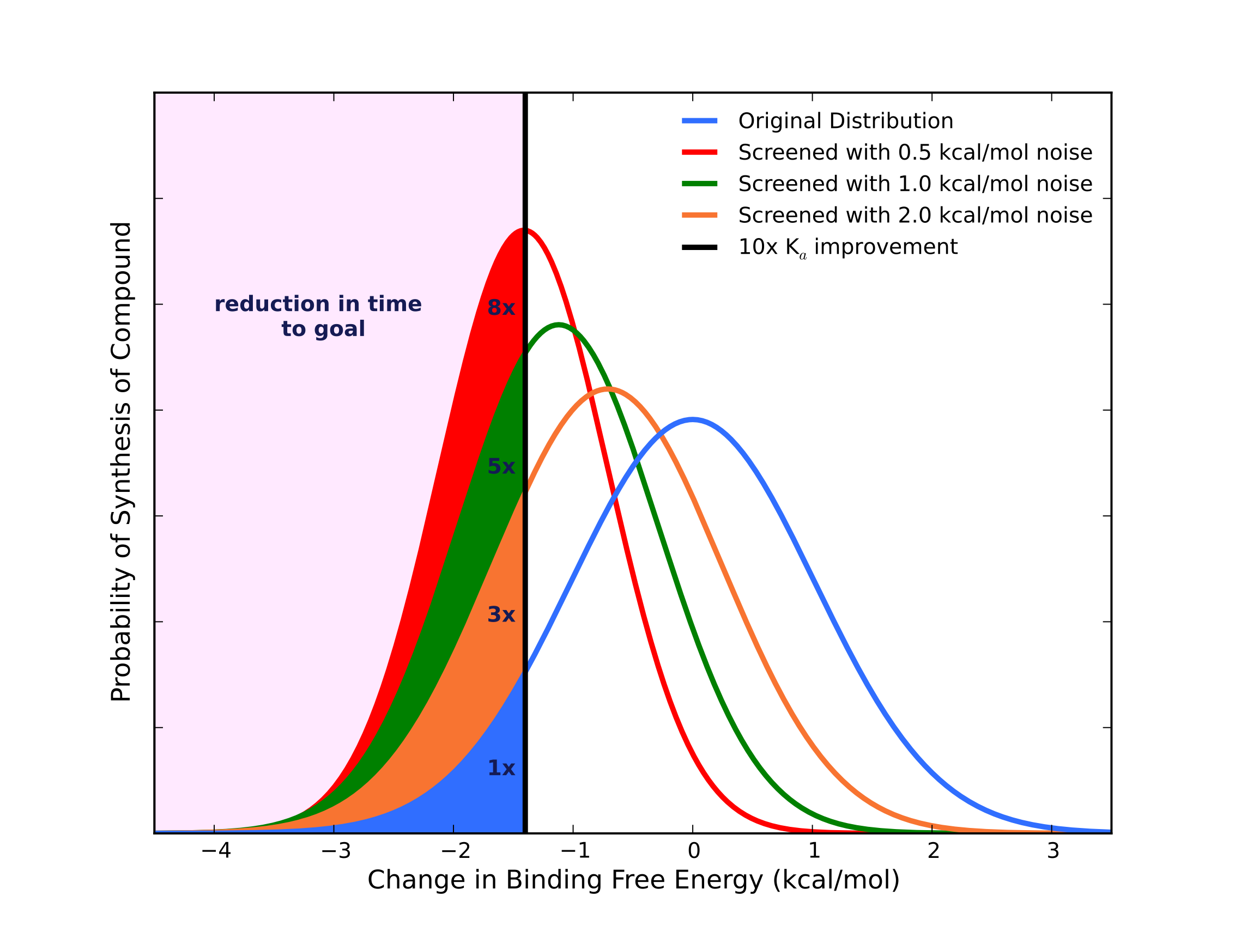
Modestly accurate ΔG○ predictions can aid drug discovery
Hypothetical pipeline:
Medicinal chemist suggests 100 derivatives or compounds per week
Your job is to pick the top 10 to carry forward
Question: How many molecules do we have to make to gain a factor of 10 in affinity?
- 0.5 kcal/mol noise: Decreases # required by 8x
- 1.0 kcal/mol noise: Decreases by 5x
- 2 kcal/mol noise: Decreases by 3x
Shirts, Mobley, and Brown, “Free Energy Calculations in Structure-based Drug Design”, in “Structure Based Drug Design” by Merz et al., Cambridge University Press, 2010. See also Mobley & Klimovich, JCP 2013
Notes:
Abbott has looked at the distribution of affinity changes due to suggested mutations and it is very nearly Gaussian
We already have better than 2 kcal/mol noise.
Thus depending on synthesis time required this can pay off.

Slide 6
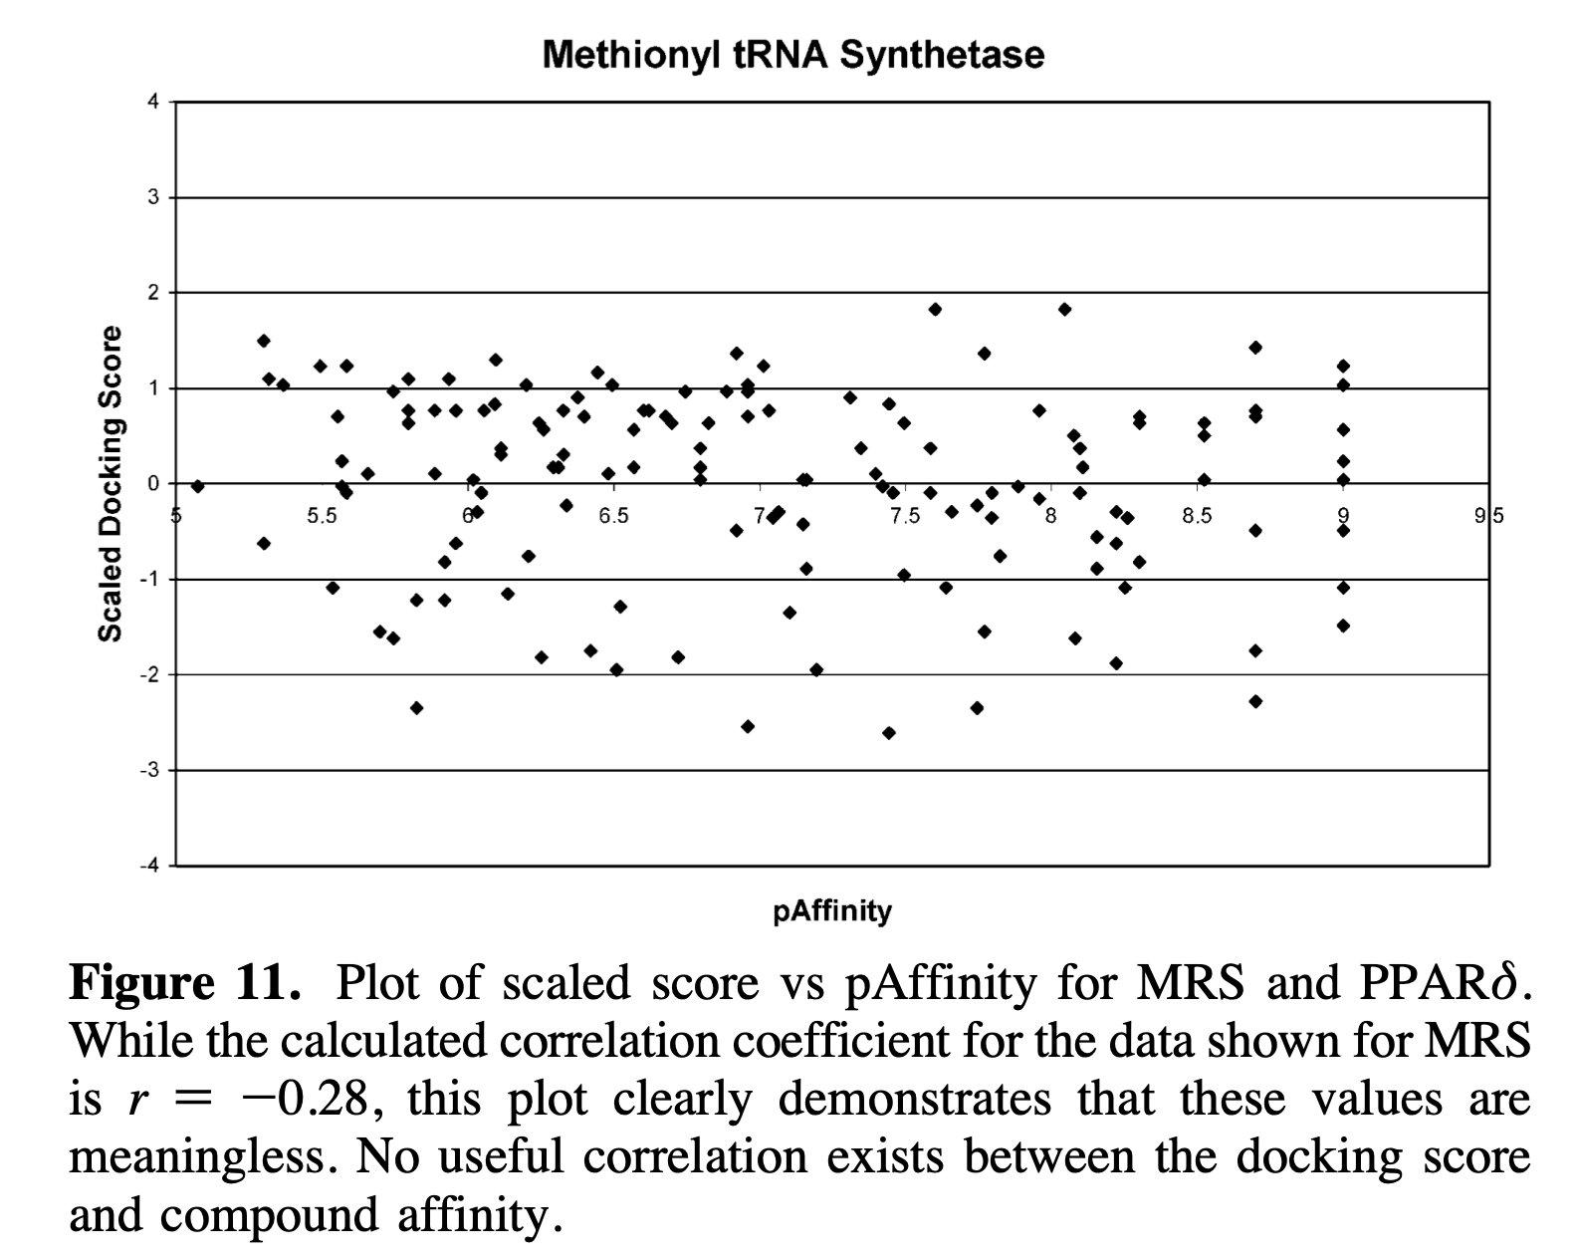
Docking scores do not correlate with ΔG○
“For prediction of compound affinity, none of the docking programs or scoring functions made a useful prediction of ligand binding affinity.”
From Warren et al. [GSK], “A Critical Assessment of Docking Programs and Scoring Functions”, J. Med. Chem. 49:5912, 2006.

Slide 7
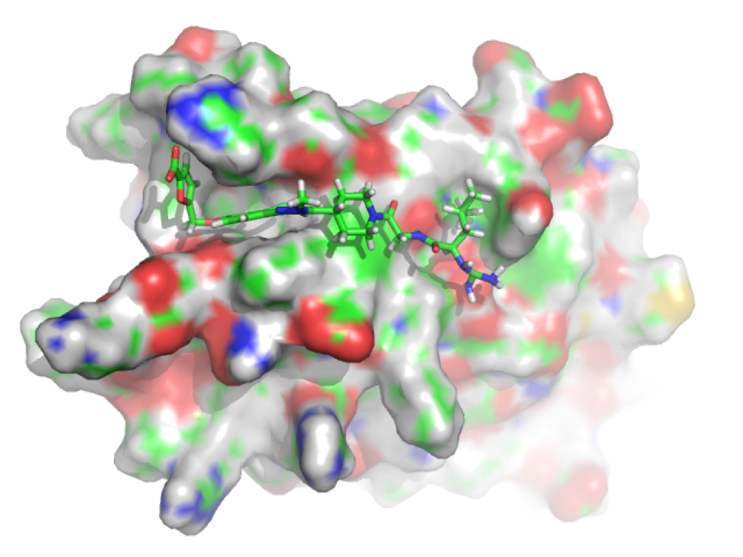
Docking approximates ΔS
ΔG = ΔH + TΔS
Docking score ~ ΔH
It sometimes involves
ad hoc ΔS based on the number of rotatable bonds
ΔGsolv
Docking is based on “optimal” configurations
(from [1])

Slide 8
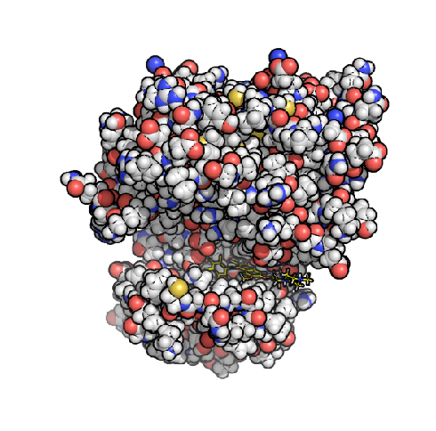
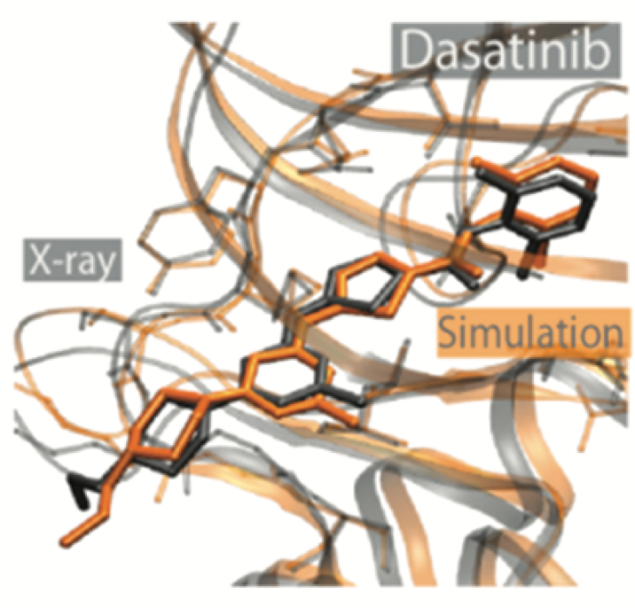

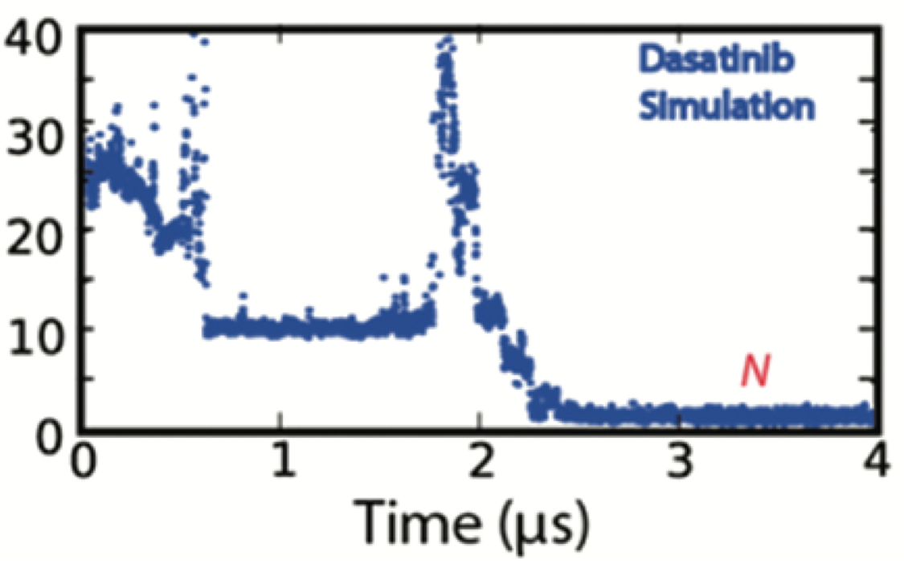
Binding free energies can be determined from long simulations
In principle, we could watch many binding/unbinding events
unbound
bound
time
but this is expensive, and only a small number of heroic simulations have been done
Src Kinase
Shan, …, Shaw, JACS 2011
Notes:
This gives the crystal structure - maybe the force field isn’t too bad!

Slide 9
Faster ΔG○ methods are based on thermodynamic cycles
Thermodynamic cycles are a series of thermodynamic processes which return to the initial state
The total free energy difference around a thermodynamic cycle is zero
Differences between free energies (and other thermodynamics state functions) may be determined indirectly

Slide 10
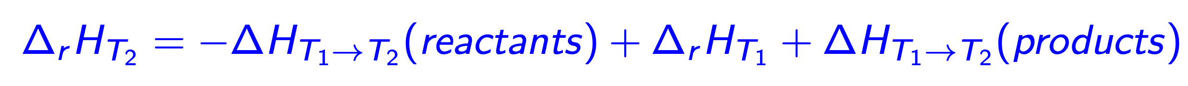
Exercise: given this themodynamic cycle, write an expression for $Δ_{r}H_{T_{2}}$ in terms of $Δ_{r}H_{T_{1}}$, $Δ_{r}H_{T_{1}→T_{2}(reactants)}$, and $Δ_{r}H_{T_{1}→T_{2}(products)}$.
$$Δ_{r}H_{T_{2}}$$
Reactants, T2
Products, T2
$$ΔH_{T_{1}→T_{2}}(\text{reactants})$$
$$ΔH_{T_{1}→T_{2}}(\text{products})$$
$$Δ_{r}H_{T_{1}}$$
Reactants, T1
Products, T1

Slide 11
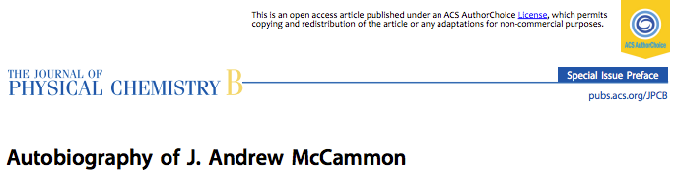
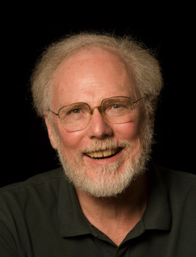
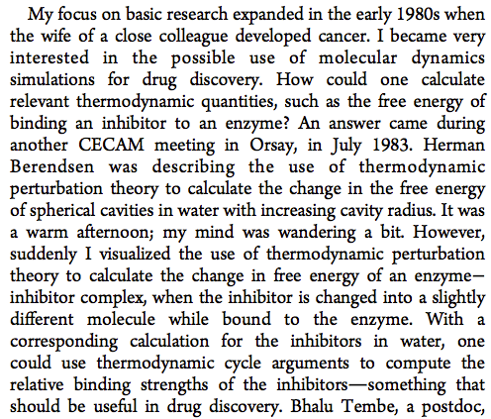
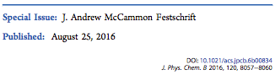

Slide 12
Thermodynamic cycles in ΔG○ calculations
Most binding free energy calculations use thermodynamic cycles that include alchemical processes where intermediate states do not necessarily model a physical system, e.g.
a drug lead can be morphed into a similar compound (McCammon’s idea)
harmonic restraints can be added to keep atoms in a certain position
states whose energy is a linear interpolation between states 0 and 1 can be defined as, $U_{λ}(r^{N})=(1-λ)U_{0}(r^{N})+λU_{1}(r^{N})$
Absolute ΔG○ often use
restraints to physically separate the receptor and ligand
alchemical transformations to decouple a receptor and ligand
Relative binding free energies, ΔΔG○, are usually calculated by transforming one small molecule into another

Slide 13



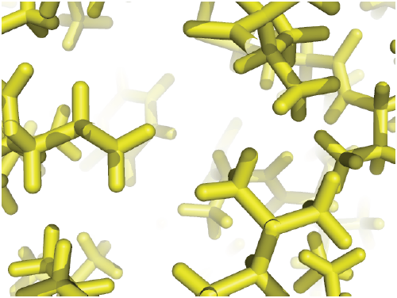
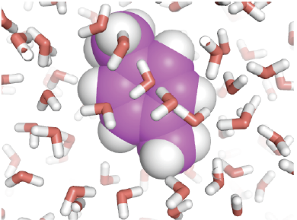
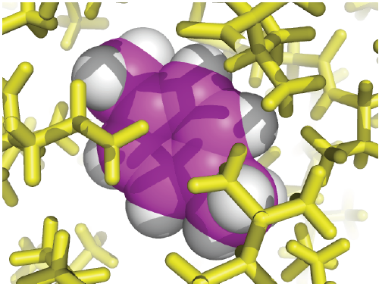
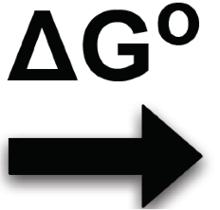



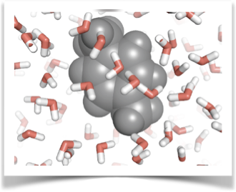
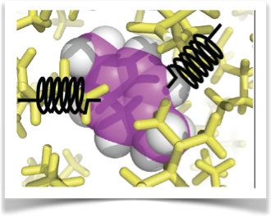
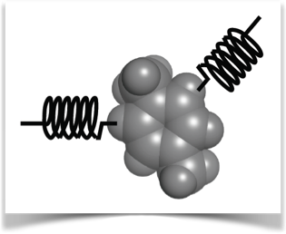
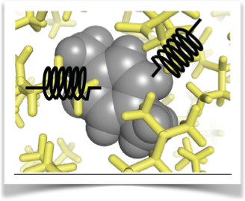


A Thermodynamic Cycle for Absolute ΔG of Binding
Cycle: Boresch et al., J. Phys. Chem. B 107:9535 (2003)
See also Gilson, Biophys J. 1997.
From [1]
Notes:
Discuss here that we are using MD simulations (AMBER FF, GROMACS) to get at the ratio of partition functions

Slide 14
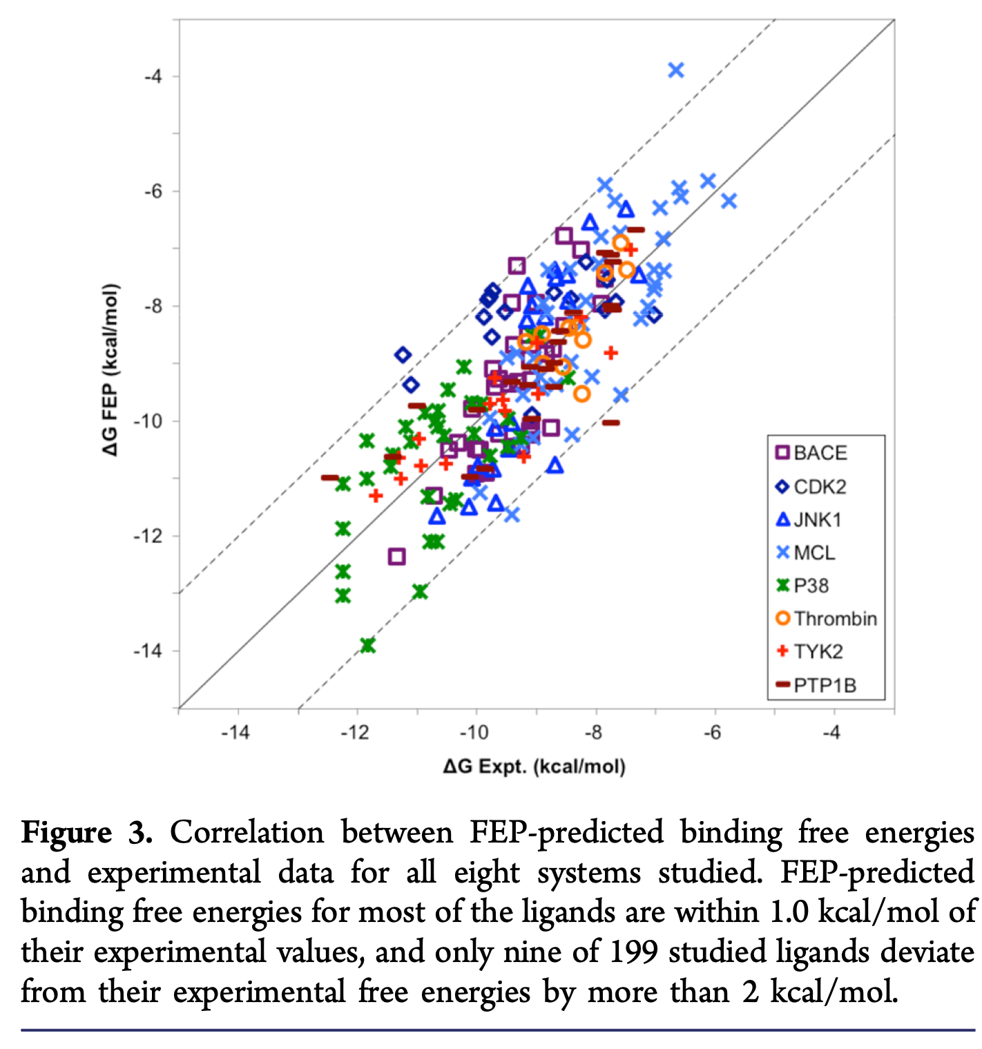
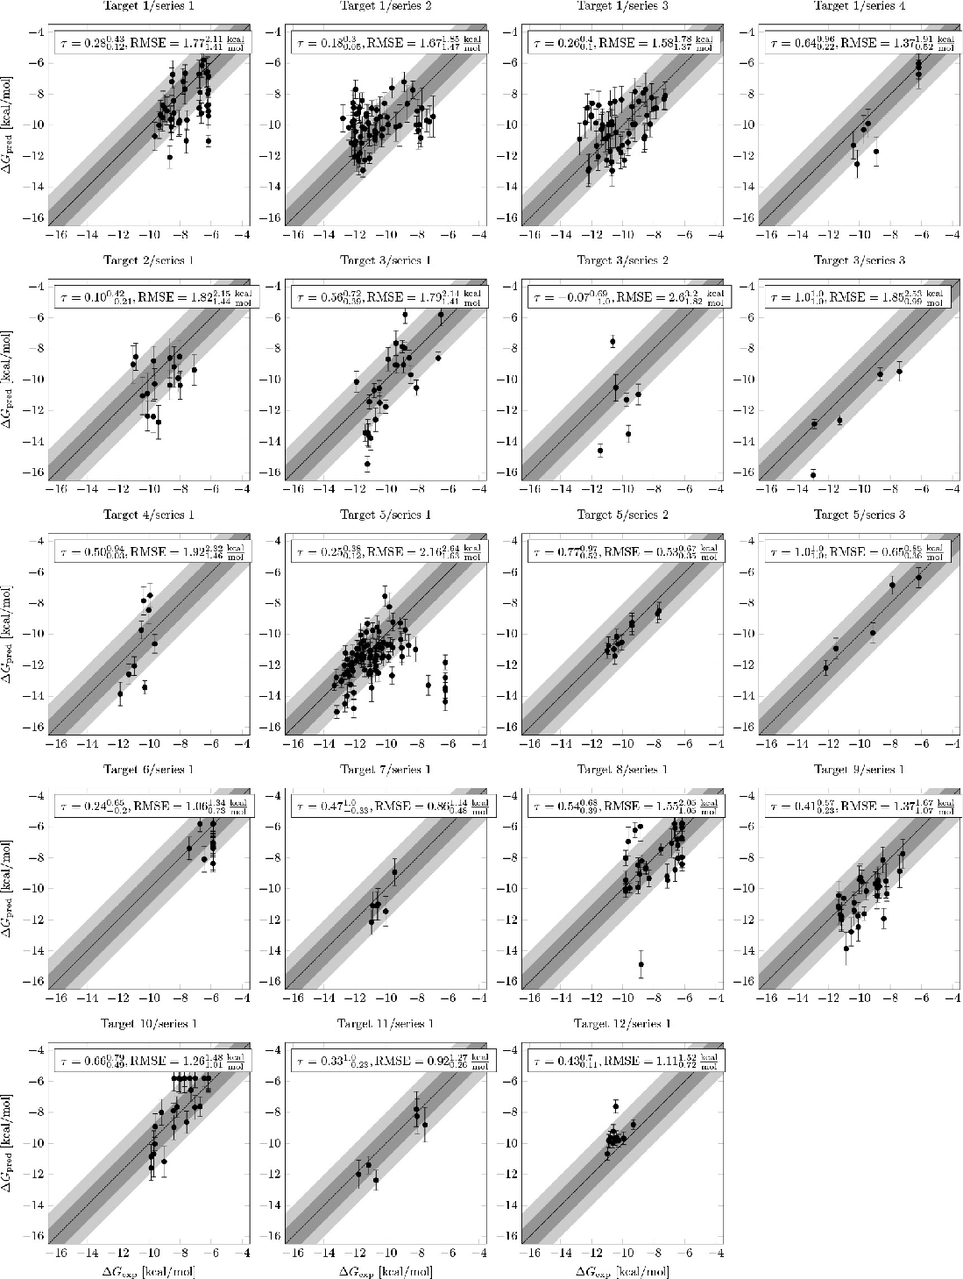
Alchemical methods can accurately calculate small ΔΔG○
from Wang et al. [Schrodinger], J. Am. Chem. Soc. 137:2695-2703 (2015)
Figure 3. Prospective FEP+ results from 12 targets and 19 chemical series. From Schindler et al. [Merck] J. Chem. Inf. Model. 60:5457-5474 (2020)

Slide 15
Review
How do binding free energy calculations differ from molecular docking?
What is a thermodynamic cycle? What types of thermodynamic cycles are used in binding free energy calculations?
What is an alchemical transformation?

Slide 16
YANK
is a software package for performing absolute binding free energy calculations
uses a thermodynamic cycle with alchemical transformations (http://getyank.org/latest/theory.html)
It uses several specialized algorithms
Thermodynamic states are coupled by replica exchange: configurations from different thermodynamic states are periodically exchanged
Equilibration time is automatically estimated based on the sum of potential energies in all states. http://getyank.org/latest/algorithms.html#automated-equilibration-detection
Free energies are computed with the multistate Bennett acceptance ratio (MBAR). http://getyank.org/latest/algorithms.html#analysis-with-mbar
These and others are described here: http://getyank.org/latest/algorithms.html

Slide 17
YANK examples
Let’s look at an example
a control script: https://github.com/choderalab/yank-examples/blob/master/examples/binding/host-guest/repex.yaml
To run it
`git clone https://github.com/choderalab/yank-examples.git`
yank-examples/examples/binding/host-guest$ yank script --yaml=repex.yaml

Slide 18
Additional Resources
Resource for alchemical binding free energy calculations (http://www.alchemistry.org/wiki/Main_Page)

